Slide 1
Hatman: Intra-cloud Trust Management for Hadoop
Safwan Mahmud Khan & Kevin W. Hamlen
2012 IEEE Fifth International Conference on Cloud Computing

Slide 2
Outline
Introduction
Overview of Hadoop Architecture
Hatman Architecture
Activity Types
Attacker Model and Assumptions
Implementation
Results and Analysis
Related work
Conclusion

Slide 3
Introduction
Data and computation integrity and security are major concerns of users of cloud computing facilities. Many production-level clouds optimistically assume that all cloud nodes are equally trustworthy when dispatching jobs; jobs are dispatched based on node load, not reputation.
If you can’t trust the infrastructure of distributed computing, then dis-trusting the resources causes an ultimate bottleneck for any transactions
Unlike sensor networks where most of the data integrity is determined and validated against other data, computation integrity doesn’t provide much flexibility and a single malicious node can have dramatic effects on the outcome of the entire cloud processing.
This paper presents a project “Hatman” that promises a full scale, data-centric, reputation-based trust management system for Hadoop Clouds with a 90% accuracy when there is 25% malicious node count.

Slide 4
Hadoop Environmental Factors
Current Hadoop research focuses on protecting nodes from being compromised in the first place.
Many Virtualization Products exist in aiding “trusted” execution of what was being provided from the Hadoop cloud

Slide 5
Hatman Introduction
Hatman introduced as second line of defense – “post execution”
Uses “behavior reputation” of the nodes as a means of filtering on future behavior – specifically using “EigenTrust”
Specifically they duplicate jobs on the untrusted network to create a discrepancy/trust matrix whose eigenvector encodes the global reputations of all nodes in the cloud
Goal(s) of Hatman:
To implement and evaluate intra-cloud trust management for a real-world cloud architecture
Adopt a data-centric approach that recognizes job replica disagreements (rather than merely node downtimes or denial-of-service) as malicious
Show how a MapReduce–style distributed computing can be leveraged to achieve purely passive, full-time, yet scalable attestation and reputation-tracking in the cloud.

Slide 6
Hadoop Architecture Overview
HDFS (Hadoop Distributed File System), a master/slave architecture that regulates file access through:
NameNodes ( a single named HDFS node that is responsible for the overarching regulation of the cluster)
DataNodes (usually a single node responsible for physical mediums associated with the cluster)
MapReduce, a popular programming paradigm is used to issue jobs (which is referenced as Hadoop’s JobTracker). Utilized by two different phases, Map and Reduce
Map phase “maps” input key-value pairs to a set of intermediate key-value pairs
Reduce phase “reduces” the set of intermediate key-value pairs that share a key to a smaller set of key-value pairs traversabe by an iterator
When a JobTracker issues a job, it tries to place the Map processes near the input data where it currently exists to reduce communication cost.

Slide 7
Hatman Architecture
Hatman (Hadoop Trust MANager)
Augments the NameNodes with a reputation-based trust management of their slave DataNodes.
NameNodes maintain trust / reputation information, primarily and solely responsible for “book-keeping” operations regarding issuing jobs to DataNodes
Restricting the book-keeping to only the named nodes reduces the attack surface in regards to the entire HDFS

Slide 8
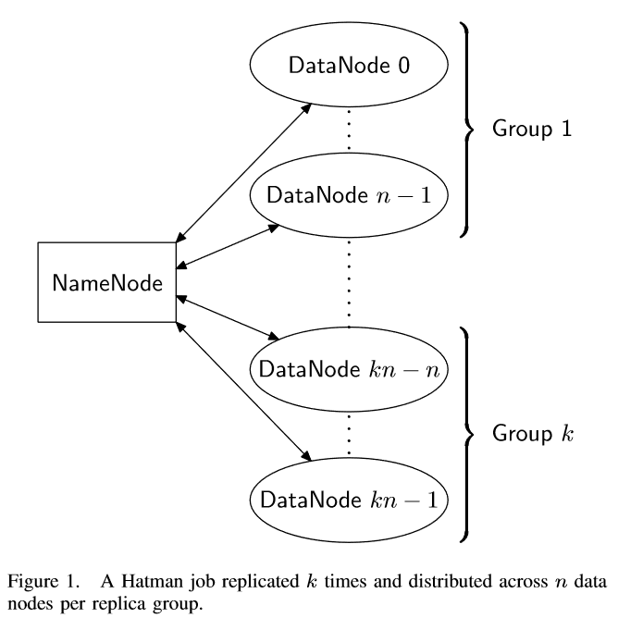
Hatman Job Replication
Jobs(J) are submitted with 2 additional fields than a standard MapReduce job
A group size – n
A replication factor – k
Each job (J) is replicated across the entire group that it was assigned too n times.
Different groups may have common DataNodes (however is uncommon in a small kn set) and each group must be unique.
Increasing n, increases parallelism and increased performance
Increasing k yields higher replication and increased security

Slide 9
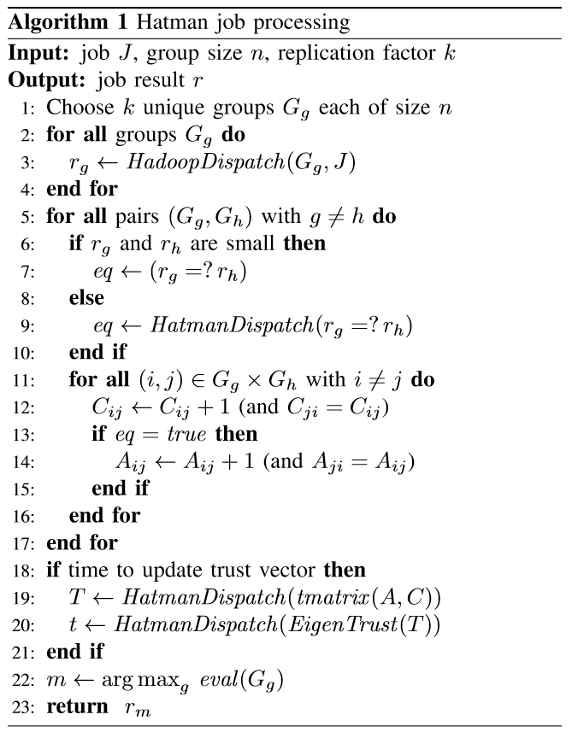
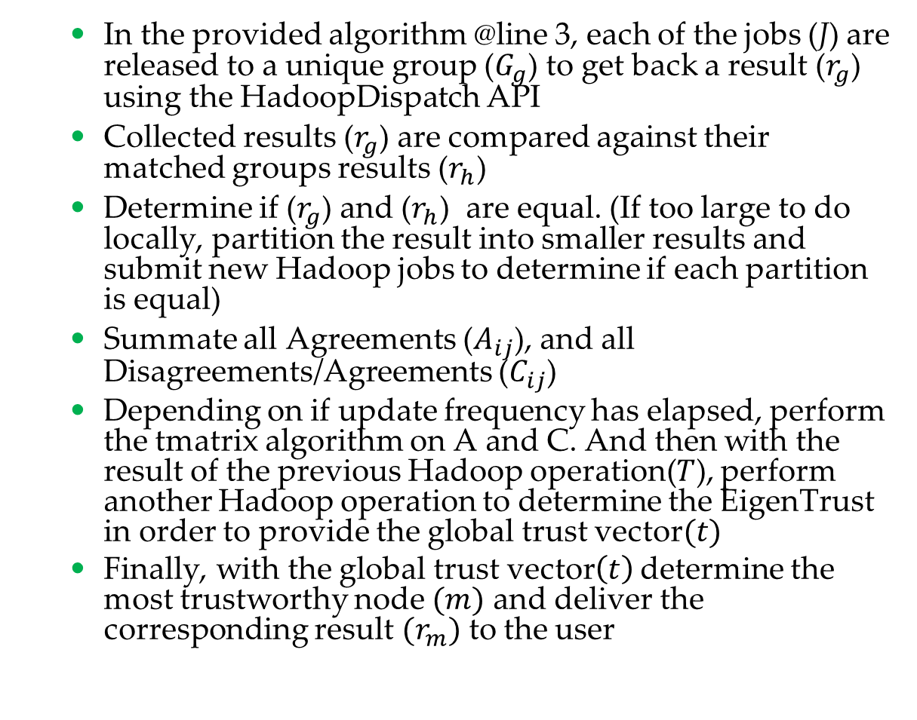
Hatman Job Processing Algorithm
In the provided algorithm @line 3, each of the jobs (J) are released to a unique group ($G_{g}$) to get back a result ($r_{g}$) using the HadoopDispatch API
Collected results ($r_{g}$) are compared against their matched groups results ($r_{h}$)
Determine if ($r_{g}$) and ($r_{h}$) are equal. (If too large to do locally, partition the result into smaller results and submit new Hadoop jobs to determine if each partition is equal)
Summate all Agreements ($A_{ij}$), and all Disagreements/Agreements ($C_{ij}$)
Depending on if update frequency has elapsed, perform the tmatrix algorithm on A and C. And then with the result of the previous Hadoop operation($T$), perform another Hadoop operation to determine the EigenTrust in order to provide the global trust vector$(t)$
Finally, with the global trust vector$\left(t\right)$ determine the most trustworthy node $(m)$ and deliver the corresponding result ${(r}_{m})$ to the user

Slide 10
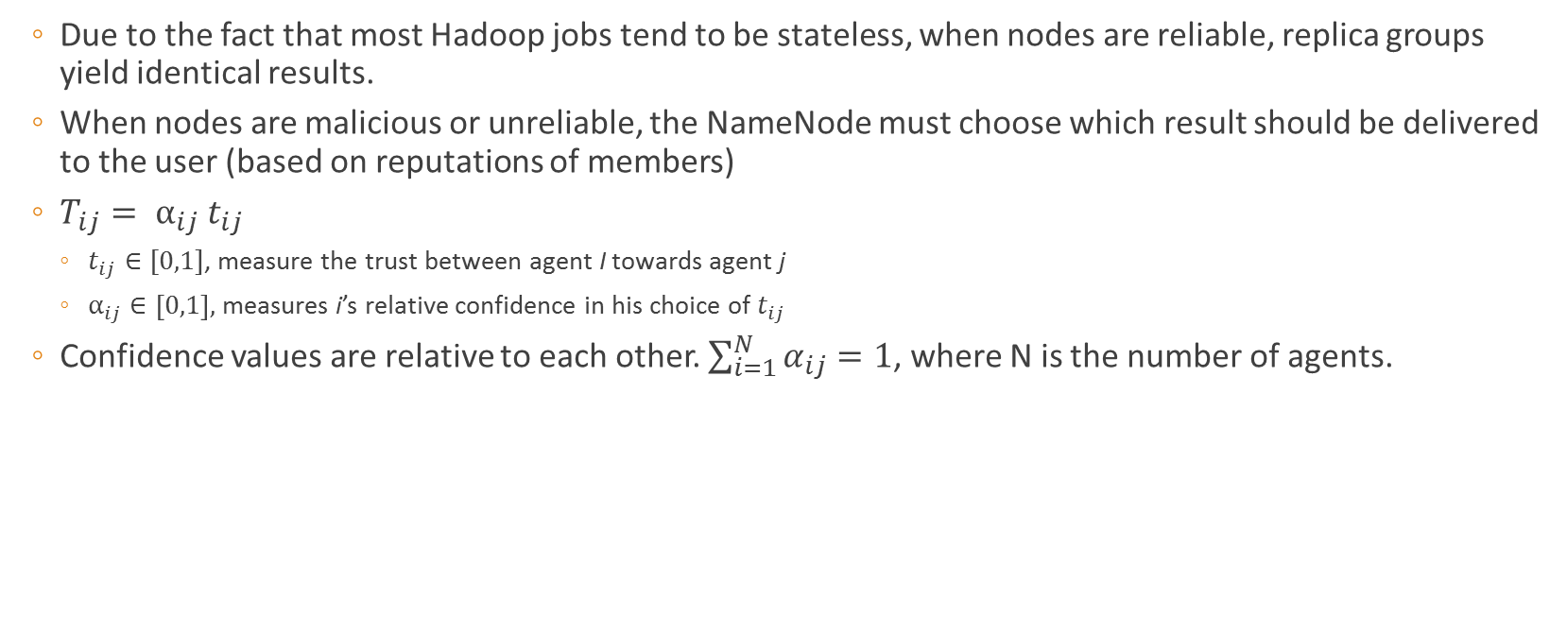
Local Trust Matrix
Due to the fact that most Hadoop jobs tend to be stateless, when nodes are reliable, replica groups yield identical results.
When nodes are malicious or unreliable, the NameNode must choose which result should be delivered to the user (based on reputations of members)
$T_{ij}= α_{ij} t_{ij}$
$t_{ij}∈[0,1]$, measure the trust between agent I towards agent j
$α_{ij}∈\left[0,1\right],$ measures i’s relative confidence in his choice of $t_{ij}$
Confidence values are relative to each other. $\sum_{i=1}^{N}{α_{ij}=1}$, where N is the number of agents.

Slide 11
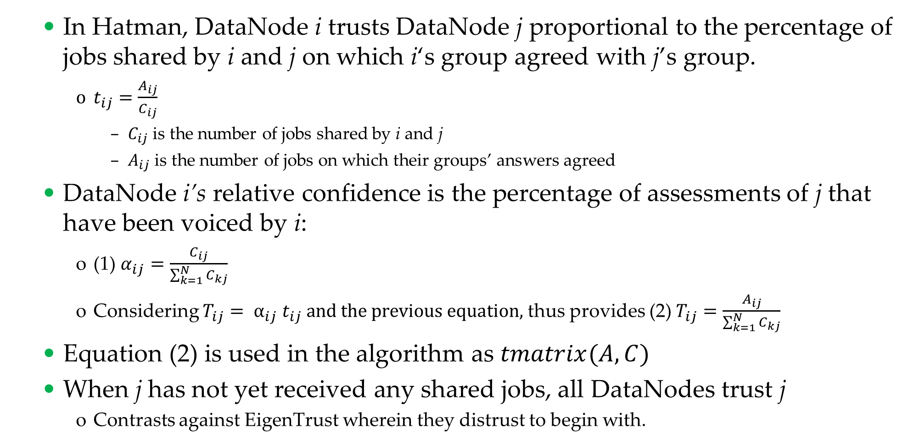
Global Trust Matrix
In Hatman, DataNode i trusts DataNode j proportional to the percentage of jobs shared by i and j on which i‘s group agreed with j’s group.
$t_{ij}=\frac{A_{ij}}{C_{ij}}$
$C_{ij}$ is the number of jobs shared by i and j
$A_{ij}$ is the number of jobs on which their groups’ answers agreed
DataNode i’s relative confidence is the percentage of assessments of j that have been voiced by i:
(1) $α_{ij}=\frac{C_{ij}}{\sum_{k=1}^{N}{C_{kj}}}$
Considering $T_{ij}= α_{ij} t_{ij} and the previous equation,$thus provides (2) $T_{ij}=\frac{A_{ij}}{\sum_{k=1}^{N}{C_{kj}}}$
Equation (2) is used in the algorithm as $tmatrix(A, C)$
When j has not yet received any shared jobs, all DataNodes trust j
Contrasts against EigenTrust wherein they distrust to begin with.

Slide 12
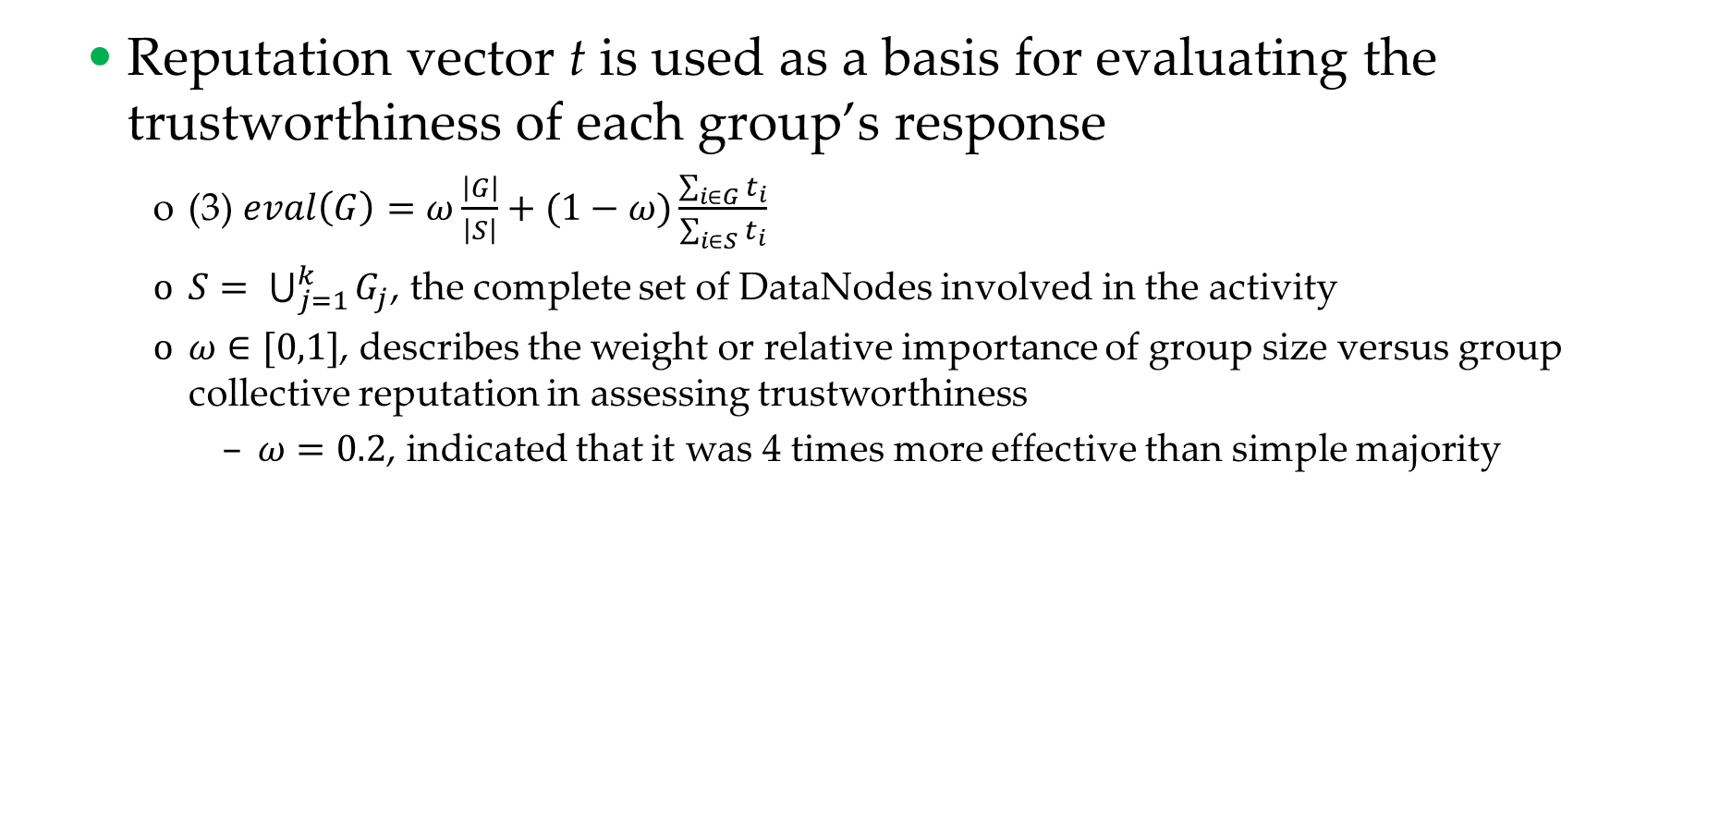
EigenTrust Evalution
Reputation vector t is used as a basis for evaluating the trustworthiness of each group’s response
(3) $eval\left(G\right)=ω\frac{\left|G\right|}{\left|S\right|}+(1−ω)\frac{\sum_{i∈G}{t_{i}}}{\sum_{i∈S}{t_{i}}}$
$S= \bigcup_{j=1}^{k}{G_{j}}$, the complete set of DataNodes involved in the activity
$ω∈[0,1]$, describes the weight or relative importance of group size versus group collective reputation in assessing trustworthiness
$ω=0.2$, indicated that it was 4 times more effective than simple majority

Slide 13
Activity Types
An activity is a tree of sub-jobs whose root is a job J submitted to Algorithm 1.
User-submitted Activity: Jobs submitted by the customer with values of n and k, take the highest priority and may be most costly
Bookkeeping Activity: Jobs that are the result comparisons and trust matrix computations jobs used in conjunction of Algorithm 1.
Police Activity: dummy jobs to exercise the system.

Slide 14
Attacker Model and Assumptions
In the paper’s attack model they indicate
DataNodes can (and will ) submit malicious content and are assumed corruptible
NameNodes are trusted and not comprisable
Man-in-the-middle is concerned not possible due to cryptographic communication

Slide 15
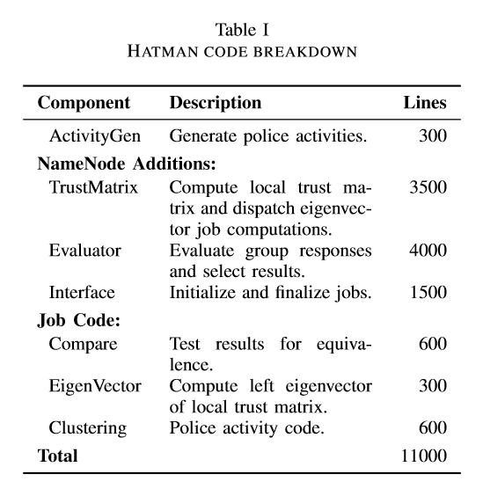
Implementation
Written in Java
11000 lines of code
Changes NetworkTopology, JobTracker, Map, and Reduce from Hadoop
Police Activities (generated from ActivityGen) are used to demonstrate and maximize effectiveness of the system
n=1, k=3
10,000 data points
Hadoop cluster, 8 DataNodes, 1 NameNode
2/8 nodes malicious (submitting wrong values randomly)

Slide 16
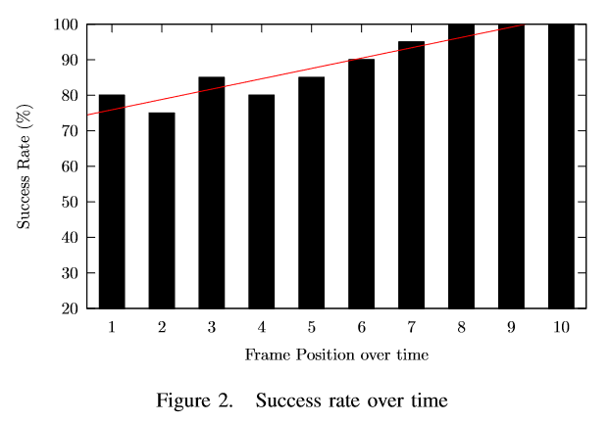
Results and Analysis
In Equation 3, weights are set to .2 for group size (.8 conversely for group reputation)
Police jobs are set to 30% of total load level
Figure 2 illustrates Hatman’s success rate of selecting correct job outputs with a 25% maliscious node enivonrment.
Initially, because of lack of history, success rate is 80%
By the 8th frame, success rate is 100% (even under the presence of 25% malicious users

Slide 17
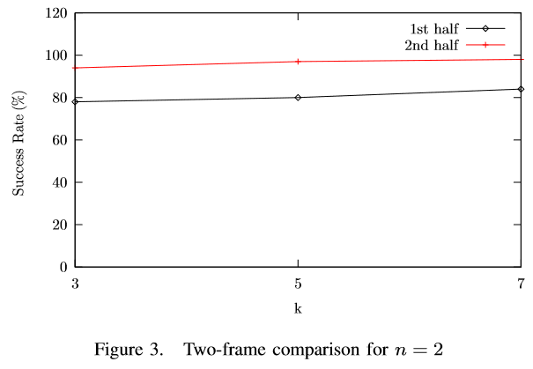
Results and Analysis (cont)
Figure 3 considers the same experiment as Figure 2, however broke into 2 halves of 100 activities
k is the replication factor used
Results are roughly equal even when segmented.
As k is increased results have very little improvement ☹
Initially from 96.33% to 100% (with a k of 7)

Slide 18
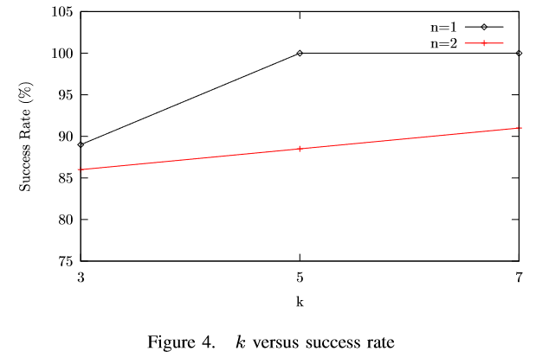
Results and Analysis (cont)
Figure 4 shows the impact on changing n (group size) and k (replication factor), and its impact on the success on the system.
As described by the author, it shows that increasing the replication factor can substantially increase the success rate for any given frame on average
When n is small (small group sizes), and k is large (higher replication factor). Success rate, can be pushed to 100%

Slide 19
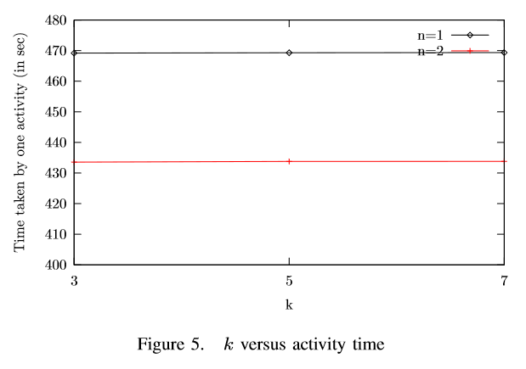
Results and Analysis (cont)
Figure 5 demonstrates the high scalability of the approach
As k (the replication factor) increases the amount of time the activity takes remains consistent.
(no need for larger replication for better speed)

Slide 20
Results and Analysis (cont) – Major Takeaways
Author believes that the Hatman solution will scale well to larger Hadoop Clusters with larger number of data nodes
As cluster and node sizes grow so does the trust matrix, and since “the cloud” is also responsible for maintaining the trust matrix no additional performance penalty is incurred.
This agrees with prior experimental work showing that EigenTrust and other similar distributed reputation-management systems will scale well to larger networks.

Slide 21
Related Work in Integrity Verification and Hadoop Trust Systems
AdapTest and RunTest
Using attestation graphs “always-agreeing” nodes form cliques quickly exposing malicious collectives
EigenTrust, NICE, and DCRC/CORC
Assess trust based on reputation gathered through personal or indirect agent experiences and feedback.
Hatman is most similar to these strategies (however it pushes the management to the cloud … special sauce??)
Some similar works have been proposed that tries to scale NameNodes in addition to data nodes.
Opera
Another Hadoop reputation based trust management system, specializing reducing downtime and failure frequency. Integrity is not concerned in this system.
Policy-based trust management provide a means to intelligently select reliable cloud resource and provide accountability but requires re-architecting the cloud APIs in order to expose more internal resources to users in order to make logical decisions

Slide 22
Conclusion
Hatman extends Hadoop clouds with reputation-based trust management of slave data nodes based on EigenTrust
All trust management computations are just more jobs on the Hadoop network, author claims this provides high scalability.
90% reliability is achieved on 100 jobs even when 25% of the network is malicious
Looking forward:
More sophisticated data integrity attacks against larger clouds
Investigate the impact of job non-determinancy on integrity attestations based on consistency-checking

